Slide 1

DSO 530 Final Project:
Algorithmic Trading
Jie Ji
Dong Wook Ko
Jingxuan Wang
Vivian Yang
Notes:
Good afternoon everyone and thank you for staying online for our presentation. I’m here today with Jie, Sam and Kenneth to present to you our take on the algorithmic trading project.

Slide 2

Agenda
Problem & Workflow
Additional Feature Engineering
Linear Regression Model
Classification Model
Trading Strategy
Trading Results/Visualization
Q&A
Notes:
Here’s our agenda for today. First, I will rephrase the problem statement and give you an overview of our workflow. Then, Kenneth with talk about the additional features we engineered and our linear regression model. After that, Jie will discuss the classification model we built, and lastly Sam will talk about how we combined the models based on our trading strategy and give you an overview of our results. We’ll answer any questions at the end of the presentation.

Slide 3

Problem Overview
Based on the daily stock data of 50 companies included in the SSE 50 index, build a trading algorithm that maximizes the return on an initial investment of $1,000,000 after 252 days while achieving good common sense metrics in trading that appeals to investors’ risk-averse psychology.
Notes:
I’m sure you’re all familiar with the problem already but essentially, we were presented with 504 days of data from 50 stocks, and our task is to create an algorithm that can maximize our initial investment of $1 million dollars after 252 days of trading.

Slide 4
Workflow
Linear Regression
Additional Feature Engineering
Trading Strategy
Trade & Return
Classification
(Best model voted from 7 candidates)
Notes:
We approached the problem by first researching technical indicators and turning them into features in our data set that can potentially increase our profits. Then, we used the data and the engineered features to create both regression and classification models. A linear regression model with different parameters is built for each stock and a different classification method is also chosen for each stock to minimize error and maximize profit. Lastly, we created a trading strategy that combined the two models with rules for buying and selling.
Now, I’ll pass it on to Kenneth to talk about feature engineering.

Slide 5
Feature Engineering
01
Open-close ratio
Exponential Moving Average (EMA) - 5 Days & 15 Days
Trend Indicators
02
Momentum Indicators
Commodity Channel Index (CCI) - 5 Days & 15 Days
Momentum
03
Volatility Indicators
Bollinger Bands
High-Low Percentage
04
Volume Indicators
Ease of Movement (EVM)
Log Volume
Force Index

Slide 6
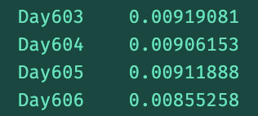
Linear Regression (OLS)
Model Design
Model Selection
Prediction Output
X variables: 11 variables provided by professor and 12 customized engineer features
Y variable: Percentage change of stock price of next day (d+1)
Training data set: data from day 17 - day 399
Validation data set: data from day 405 - day 499
Goal: We want to select strong features from 23 features in the full model to construct models with less features
Method: Backward selection
Selection indicator: adjusted R² (indirect estimation of test error)
Final output: the linear model generated percentage change of next day by average the predict percentage change of past 5 days
Notes:
Update time period for training and validation set
Update selected features
Next, our trading strategy will execute trades based upon list of predicted percentage change for each day.

Slide 7
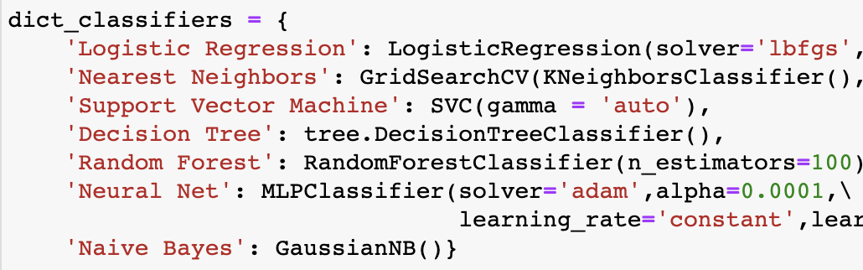
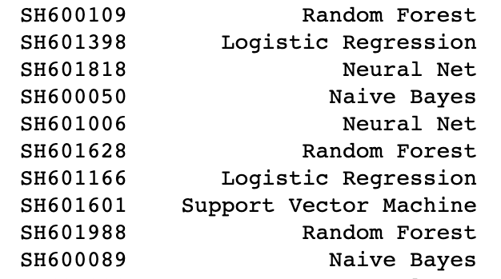
Classification
Response Variable
Model & Feature Selection
Model Training
Calculate the highest percent change over today’s close price. (The highest close price in next 5 days / today’s close price - 1 )
Y variable: Try different thresholds between 0% to 5%. We chose 2% as threshold. Any record with a percentage change over 2% will be labeled as ‘1’.
Choose the best model which has the lowest error rate for each stock.
Perform backward stepwise feature selection, choose the best number of features.
Use the before 100 days records to train the model, and predict next 20 days. After that, we train the model again and predict for another 20 days.
Notes:
For the classification model, we first built a new response variable that calculates the highest percentage change over today’s close price for the next 5-day period. This means that we used the highest close price in next 5 days divided by today’s close price and then subtracted by one. Base on this new field, we set a threshold to classify each record. When this percentage change is above the threshold, we set it to 1. Otherwise, we set it to 0. In order to set an optimal threshold, we tried several percentages between 0% to 5%, and chose to use 2% as it has the lowest error rate.
Because we still want to decrease our error rate and perform more precise predictions, we trained 50 different models on 50 stocks. We have 7 classification model candidates for each stock, From logistics regression, KNN to random forest. We feed in the data with all 23 features to test every model candidate, and then the model with the lowest overall false rate is chosen for each stock.
After we selected what model to use for each stock, we performed feature selection. So far we have 23 features, and we used backward stepwise selection to find the best number of features respectively and settled down the model.
However, unlike the regression model we built, where we trained the model using all past data of each stock, we used more recent data to train the classification model so that we can catch certain trends in a particular stock. What we did is that we trained our model repeatedly. We used 100-days of data to train the model to predict the next 20 days. After that, we train another model to predict the next 20 days.

Slide 8
Trading Strategy
Conservative
Aggressive
Distribute the total cash equally among 50 stocks
Purchase stocks only when both conditions are met
Sell stocks when even when at least 1 condition is met
Additional engineered features
Buy as many stocks as possible when expected an increase in stock price
Sell all stocks in possession when predicted no growth
5.9% Profit
Notes:
Moving on to our trading strategy, we took an approach that is both conservative and aggressive.
To be safe, we distributed the cash equally among 50 stocks to start with so that a huge drop in one stop doesn’t bring the entire portfolio to loss.
When we decided to buy, we made sure that 2 conditions are met whereas required only 1 condition when selling the stock. More details for these conditions will be covered on the next slide.
On the other hand, our trading strategy was aggressive when it comes to actually buying and selling the stocks. For example, we bought as many stocks as possible within the limit when we decided to make a purchase. Similarly, we sold all of the stocks when we decided it was time to sell. This might sounds like it will lead to high transaction cost, but we kept a very high threshold to make sure we make the purchase carefully.
Combining these 2 strategies, we were rewarded with the profit of 5.9%

Slide 9
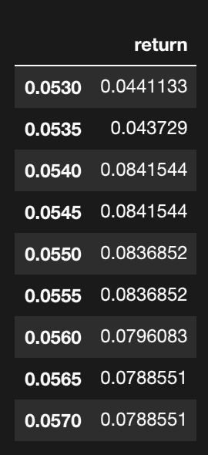
Trading Strategy
Buy
Sell
Classification label predicts an increase in stock price
and
Linear Regression predicts an growth of at least 5.5% in stock price
Classification label predicts NO increase in stock price
or
Linear Regression predicts 0% or below increase in stock price
k=5.5%
Notes:
So here are the conditions that we have set when we choose to either buy or sell stocks.
In our model, stocks were purchased only when both classification model predicted the price to increase and the regression model to predict the price will increase by more than 5.5%. This threshold of 5.5% isn’t just a random number but it is the threshold that gave us the highest return rate on our test data of 8.4%.
On the other hand, the model sold the stock if either the classification model predicted no increase in stock price or growth rate of 0% or below from the regression model.

Slide 10


Trading Results
Money at the end of Day 756:
Sharpe ratio:
Number of days a profit was made:
Notes:
As a result, here are the results of our trading model.
We ended up with $1,058,840, which is a profit of around 5.9%.
Sharpe ratio
135 days

Slide 11
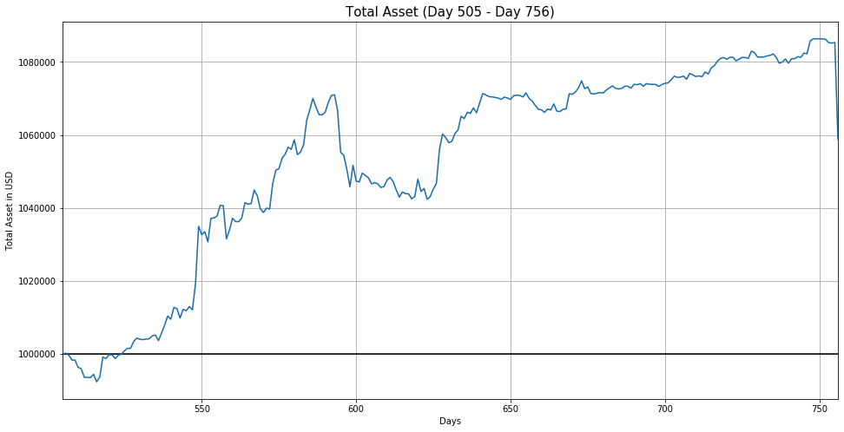
Results Graphics

Slide 12
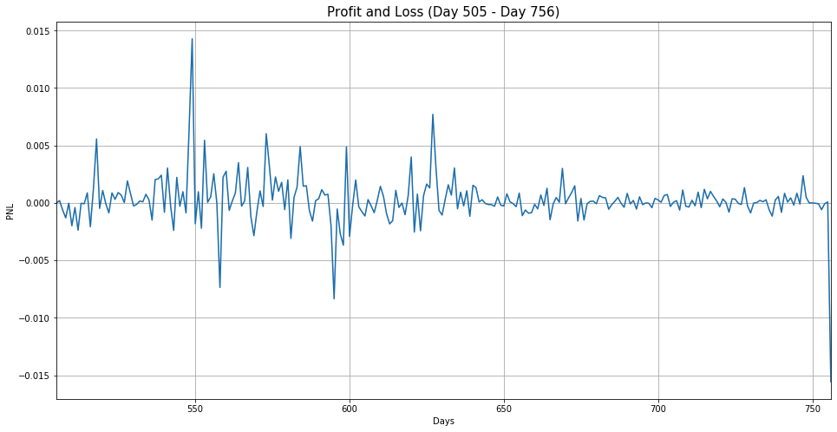
Results Graphics

Slide 13
Thank You!
Q&A

